Slide 1
Data Analyst Internship – Final Project
ApexPlanet

Slide 2
Objective
Apply data analysis concepts learned during the internship.
Work on real-world datasets.
Build a complete project portfolio.

Slide 3
Tasks Overview
Task 1: Data Exploration
Task 2: Data Visualization
Task 3: Dashboard Development
Task 4: Data Analysis (Hypothesis Testing)
Task 5: Portfolio Creation

Slide 4
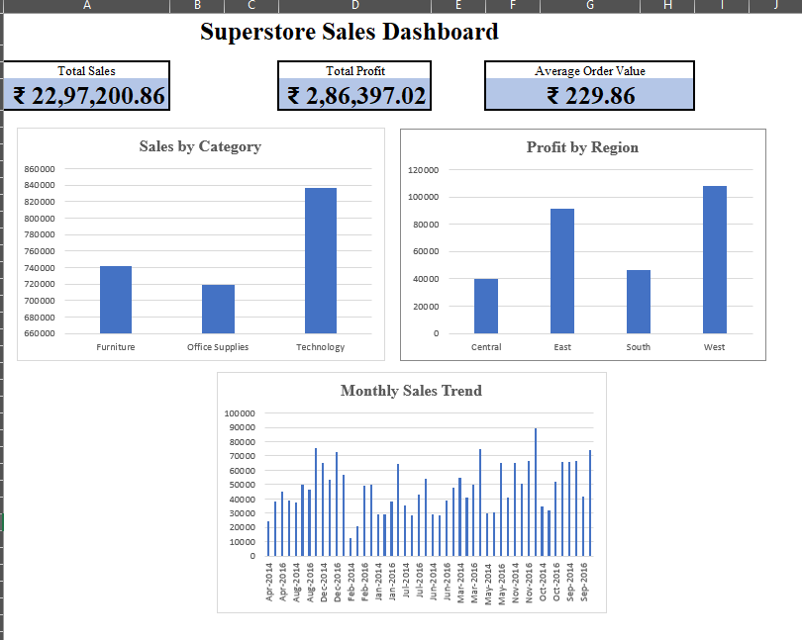
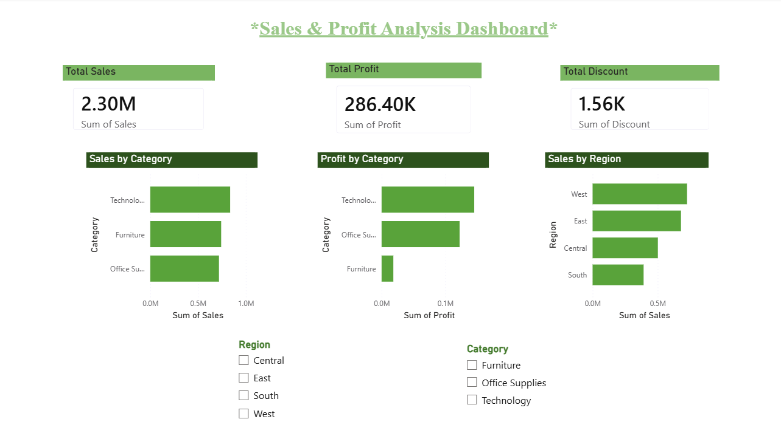
DASHBOARD VISUALIZATIONS

Slide 5

WORK DONE
Performed data cleaning and preprocessing
Conducted exploratory data analysis
Created visualizations and charts
Built an interactive dashboard
Applied hypothesis testing
This Photo by Unknown Author is licensed under CC BY-SA

Slide 6
Tools Used
Python (Pandas, NumPy)
Excel / Power BI
Data Visualization Techniques

Slide 7
Key Learnings
Importance of data cleaning.
Visualization improves insights.
Understanding real-world datasets.
Analytical thinking and problem solving.
This Photo by Unknown Author is licensed under CC BY-SA

Slide 8
Final Outcome
Completed all 5 tasks
Developed a structured GitHub portfolio
Gained practical data analysis experience
Created and published GitHub portfolio

Slide 9
Conclusion
Internship enhanced technical skills
Improved confidence in data analysis
Prepared for real-world projects
This Photo by Unknown Author is licensed under CC BY-SA

Slide 10
Thank you!
Devyani Vishwas Khandat
Email: khandatdevyani02@gmail.com

